Slide 1


Presentation on POWER BI
TASK ANALYSIS

Slide 2


AGENDA
Introduction
Importing the Dataset
Data Cleaning & Transformation
Visualizations & Metrics
Adding Interactivity
Formatting & Export
Key Takeaways
Conclusion

Slide 3
INTRODUCTION
In this project, we used Microsoft Power BI Desktop to analyze a dataset containing information about colleges and courses offered across various districts. The objective was to clean the data, derive insights, and create an interactive dashboard that allows users to explore patterns in course types, college distribution, and institutional characteristics. The final report combines DAX measures, slicers, charts, and maps to present meaningful insights for education-based decision-making.

Slide 4
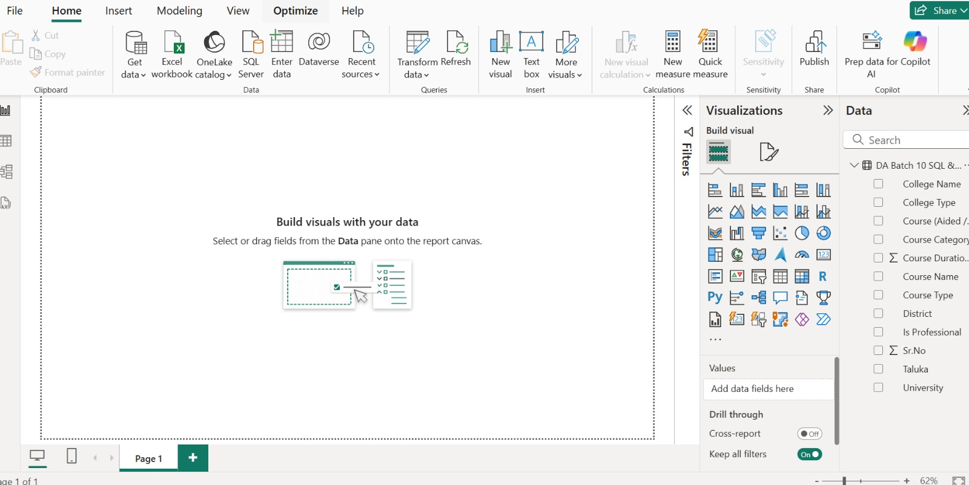
1:Connecting to the Data

Slide 5
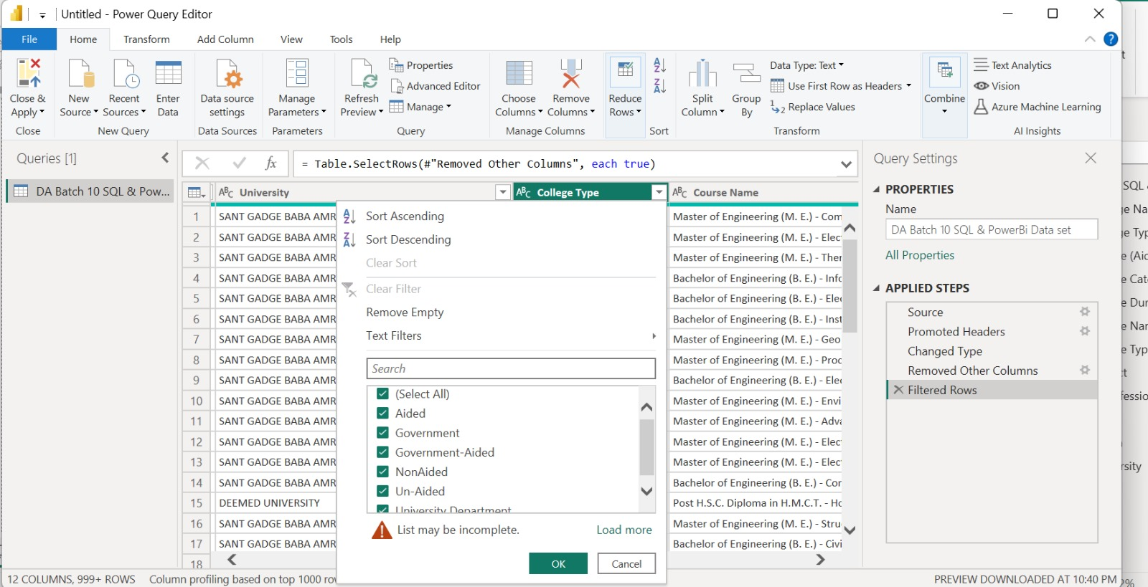
2: Data Cleaning & Preparation

Slide 6
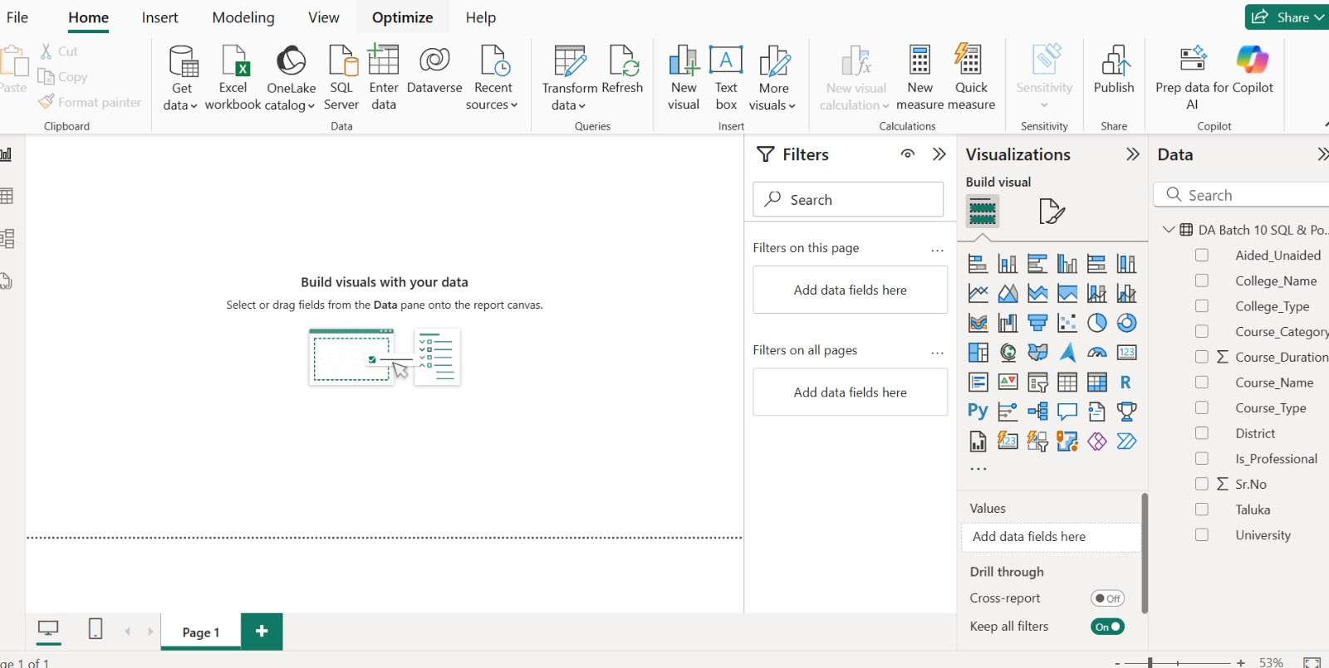

Slide 7
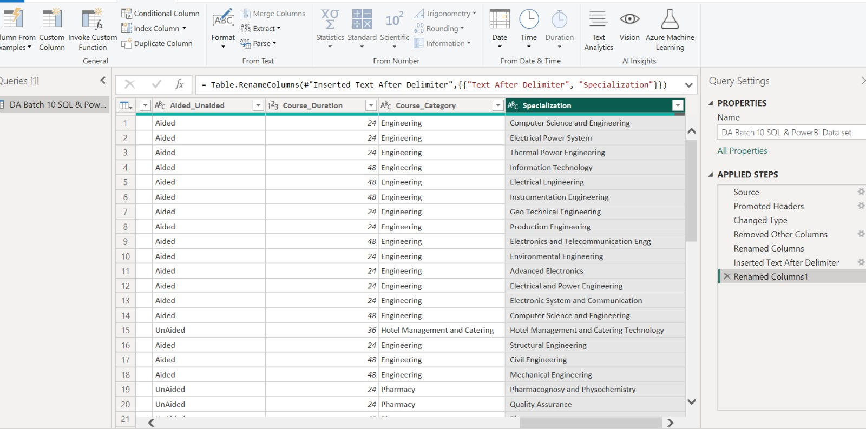
RENAMING COLUMN TO SPECIALIZATION

Slide 8
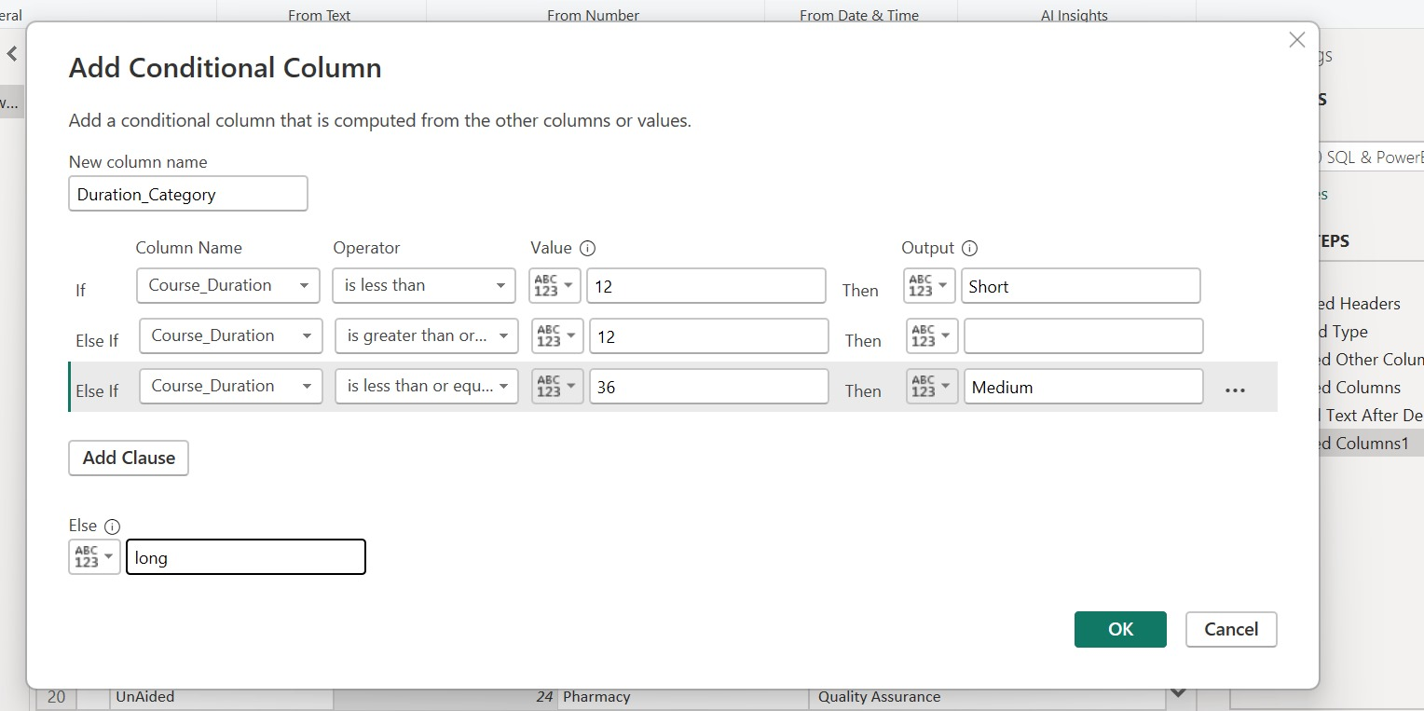
NEW COLUMN DURATION CATEGORY

Slide 9
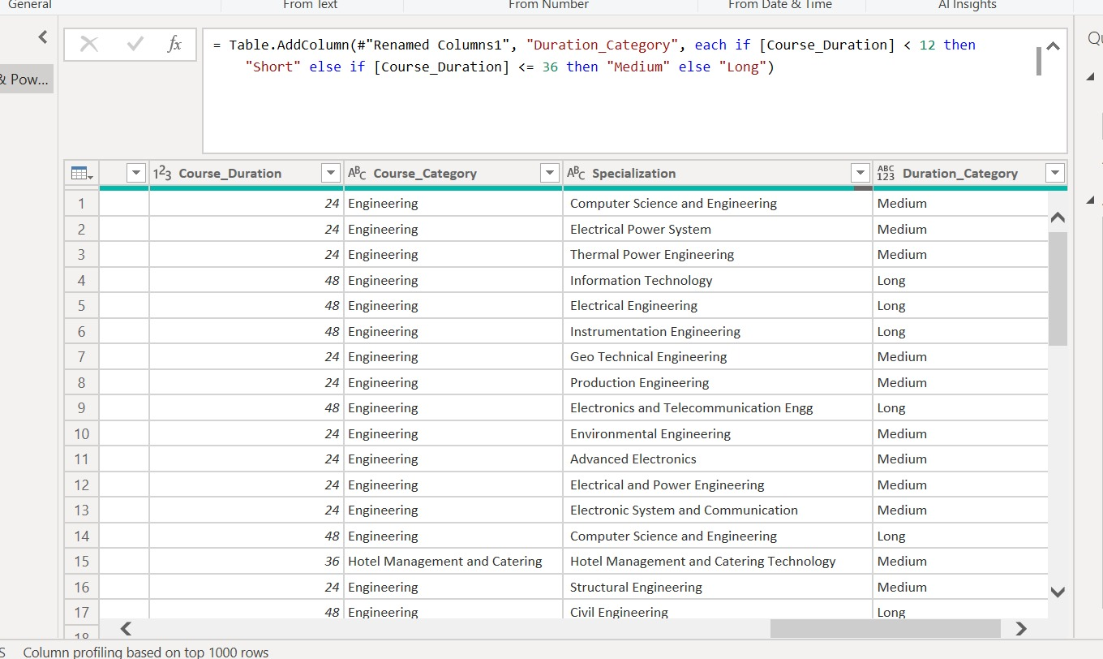

Slide 10
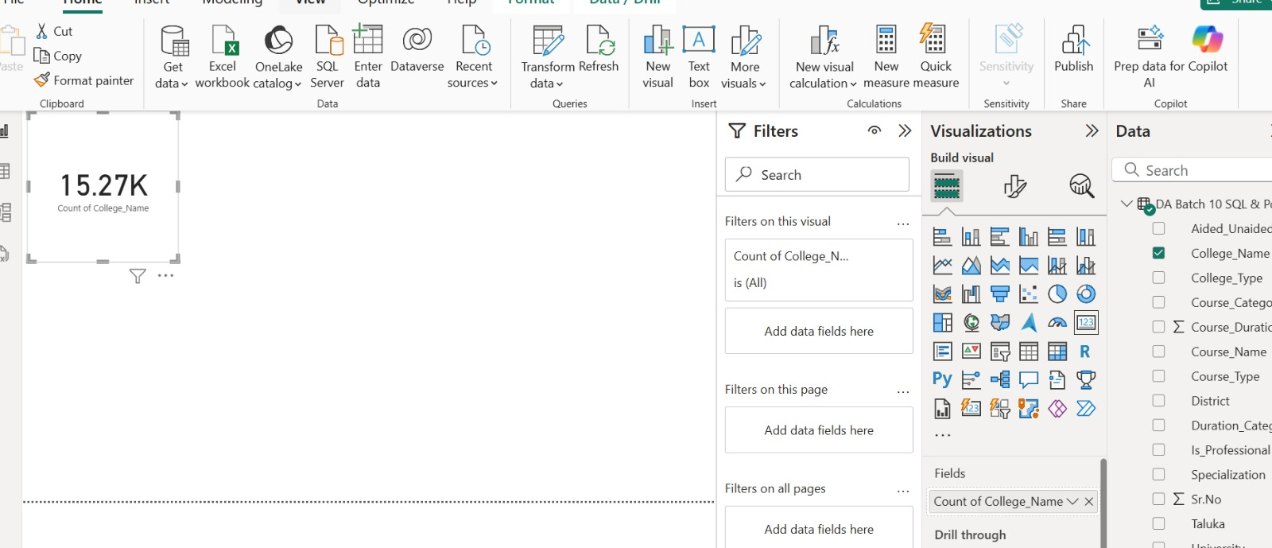
3: Creating Visualizations Total Number of Colleges

Slide 11
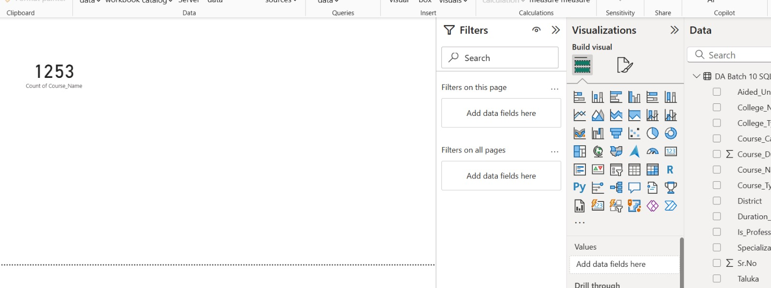
Total Unique Courses

Slide 12
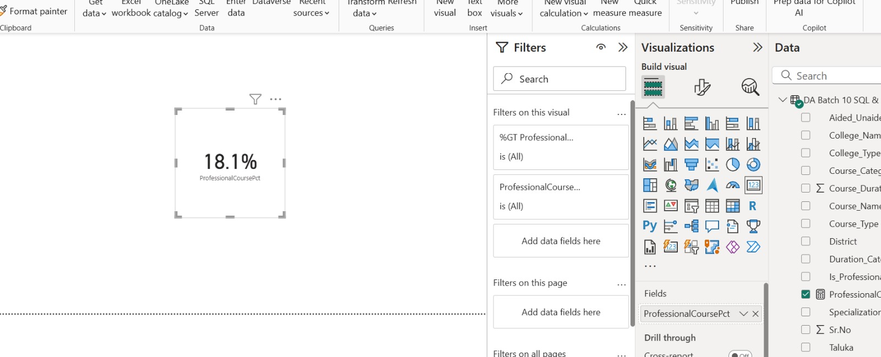
% of Professional Courses

Slide 13
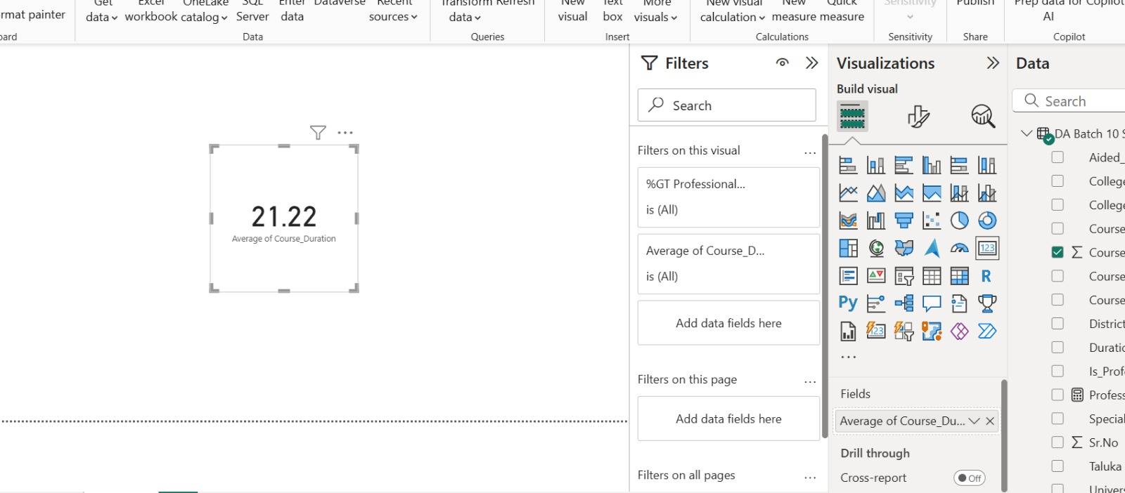
Average Course Duration

Slide 14
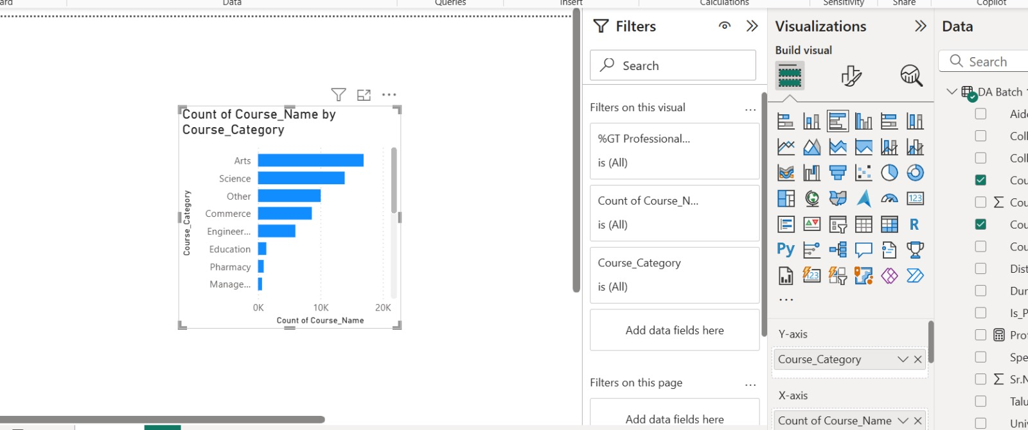
Bar Charts: Number of Courses by Course Category.

Slide 15
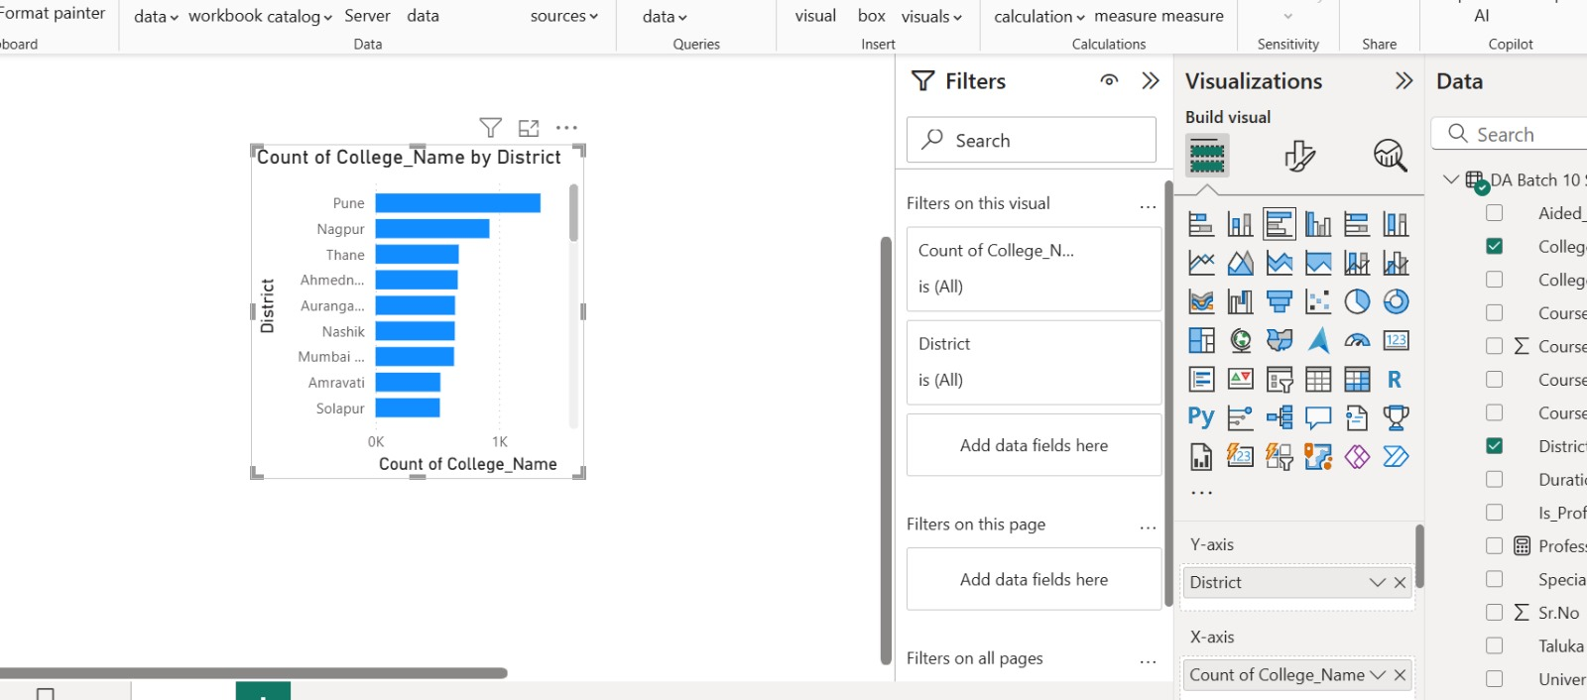
College Count by District.

Slide 16
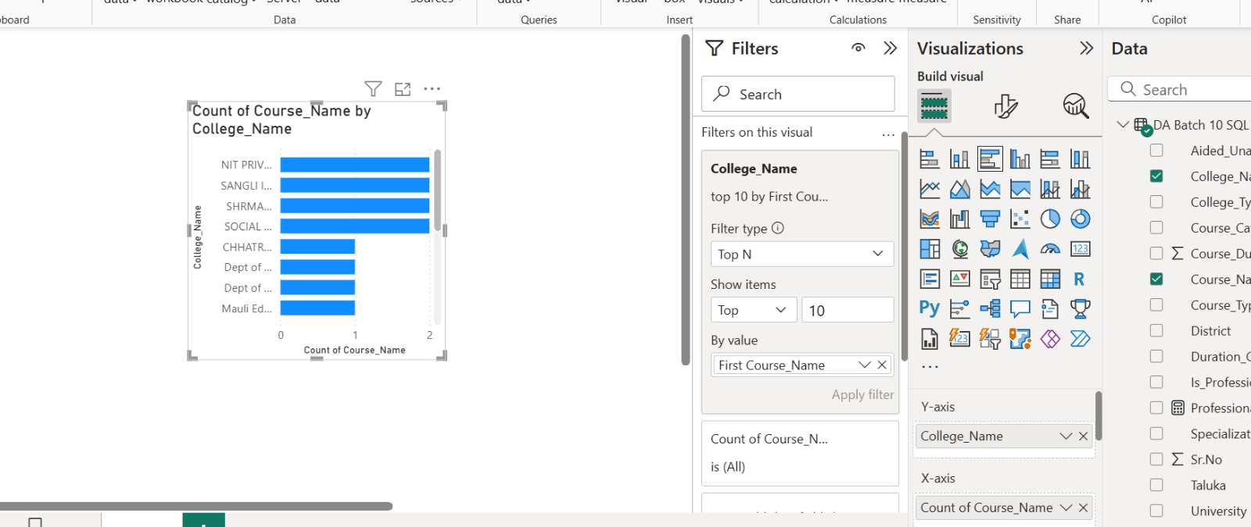
Top 10 Colleges by Course Count using a Top N filter.

Slide 17
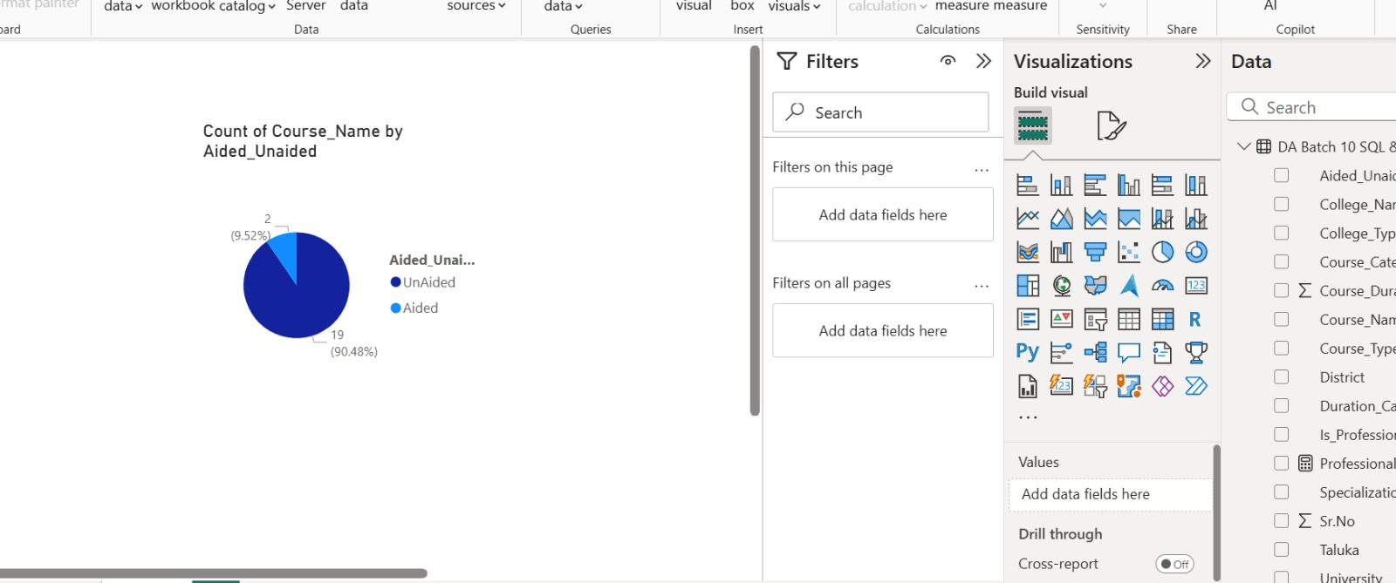
Pie Charts: Aided vs Unaided (Aided Unaided).

Slide 18
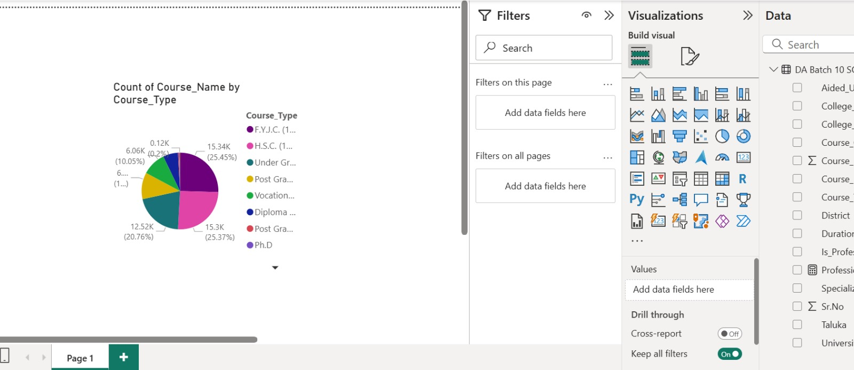
UG vs PG (Course_Type).

Slide 19
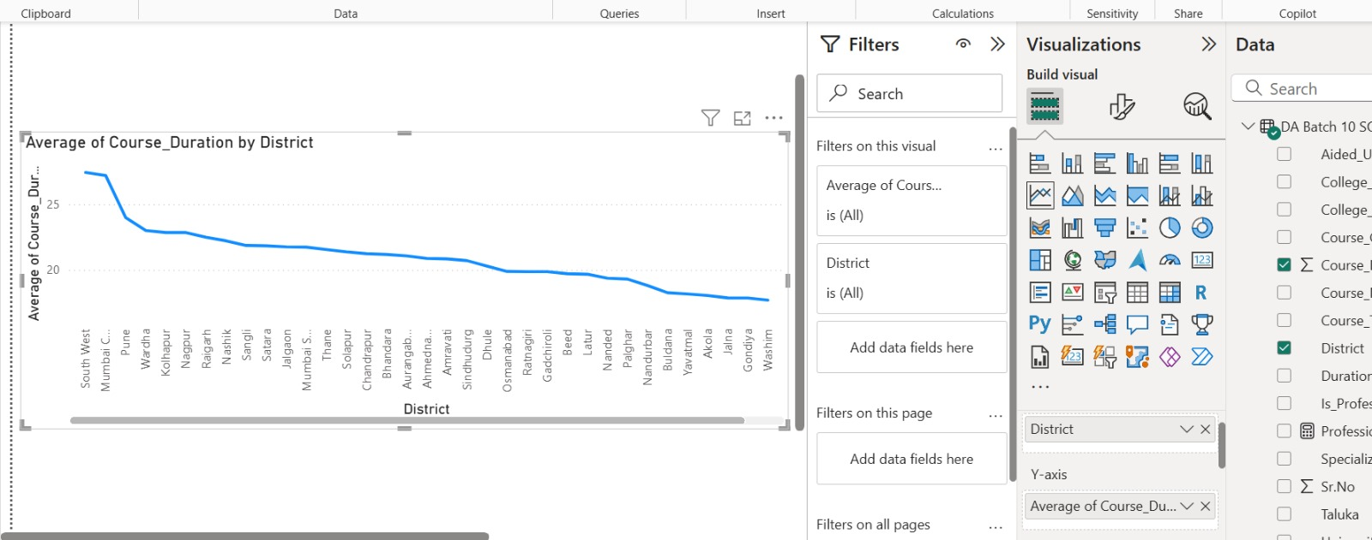
Line Chart: Average Course Duration by District

Slide 20
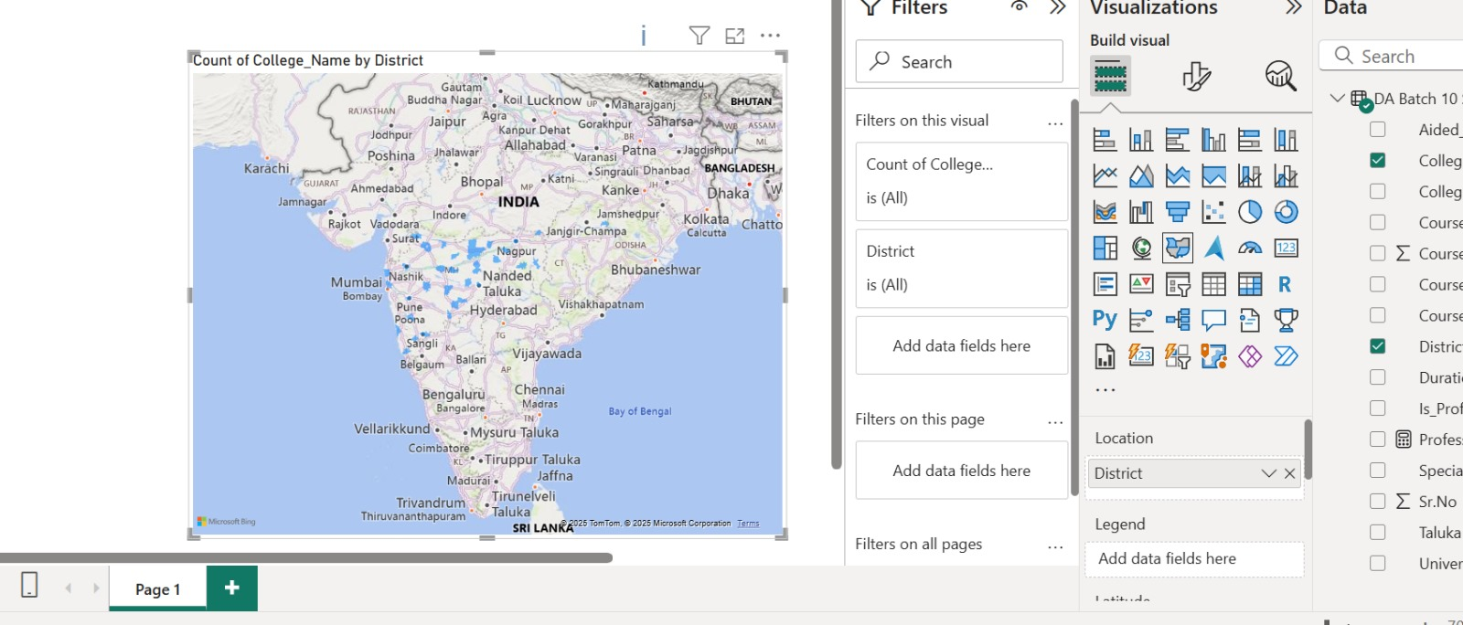
Filled Map: District as Location; Count of College_Name (Distinct) as value.

Slide 21
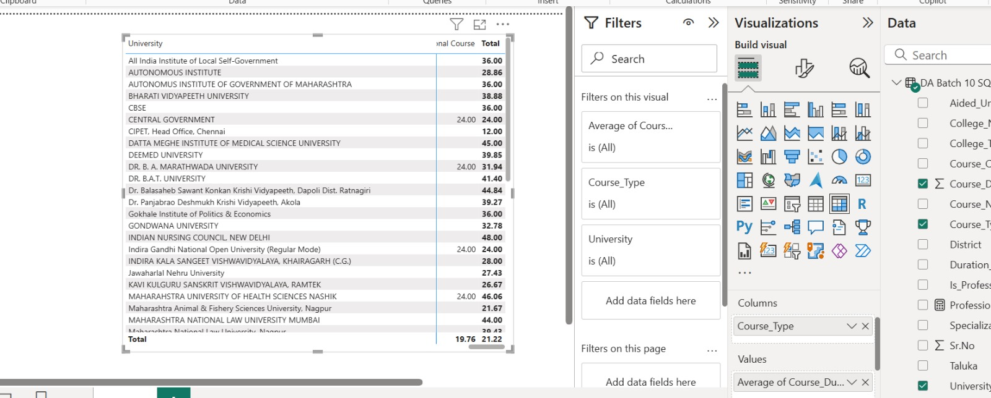
Matrix: University (Rows) vs Course_Type (Columns) with average of Course_Duration_Months.

Slide 22
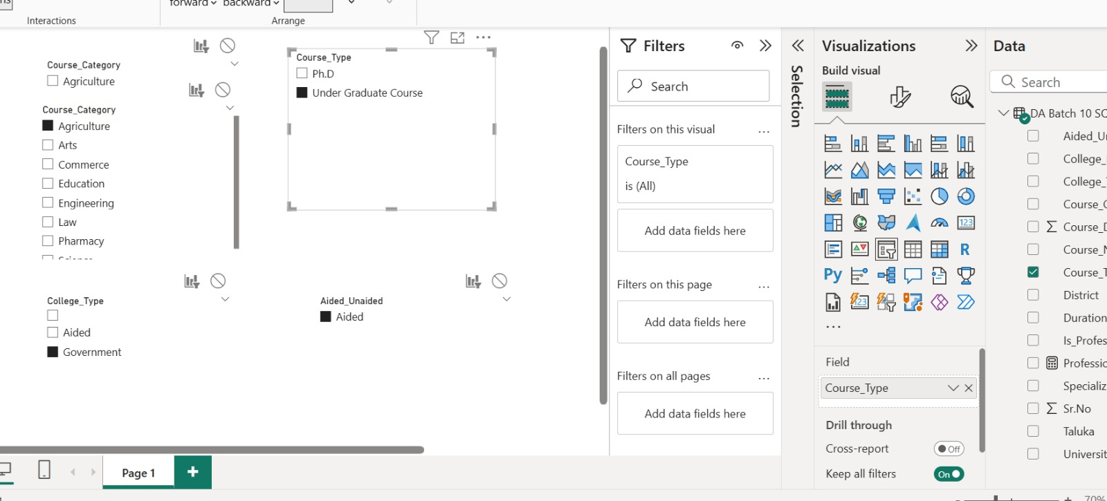
4: Adding Interactivity Course_Category

Slide 23
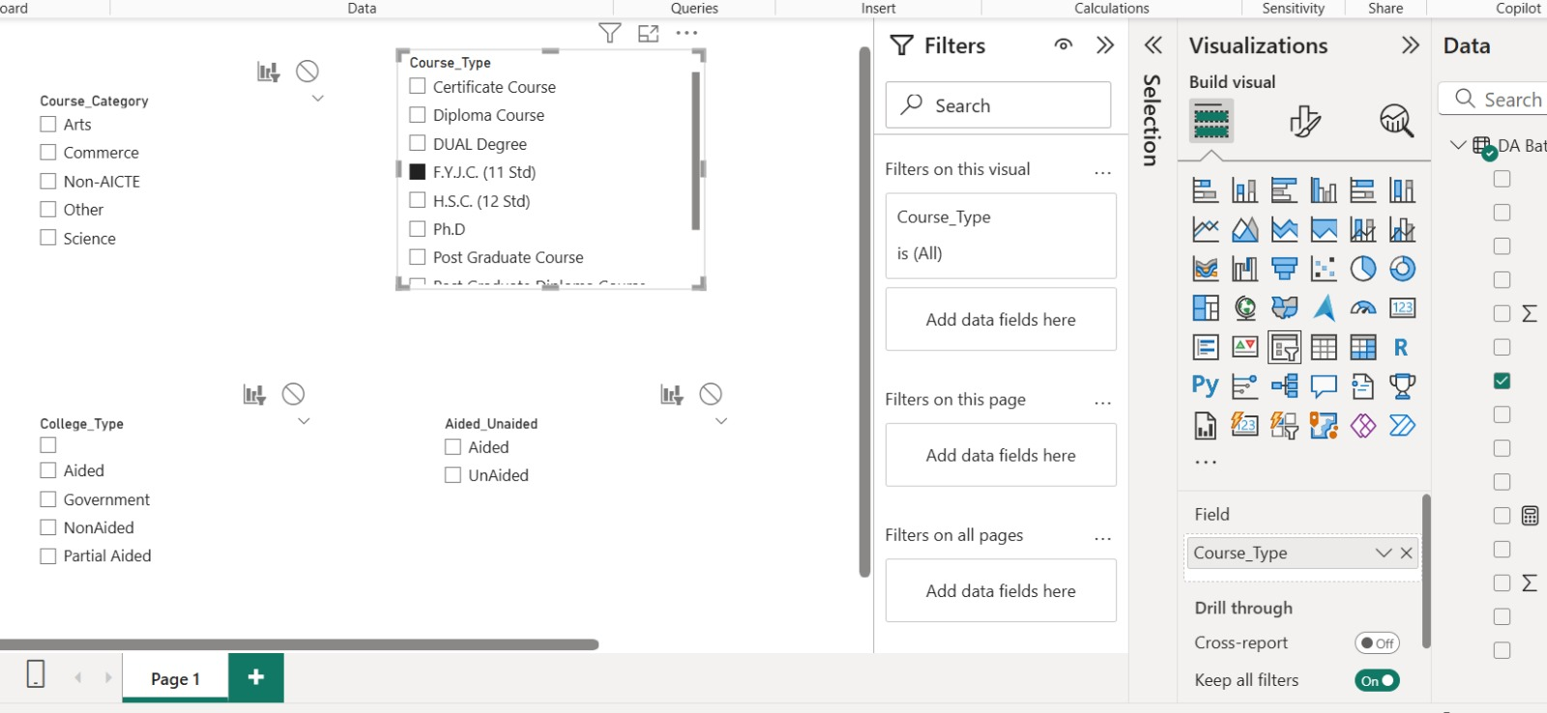
Course_Type

Slide 24
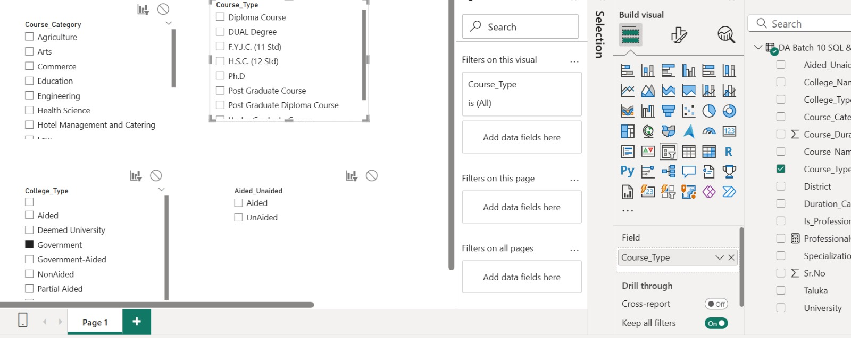
COLLEGE_TYPE

Slide 25
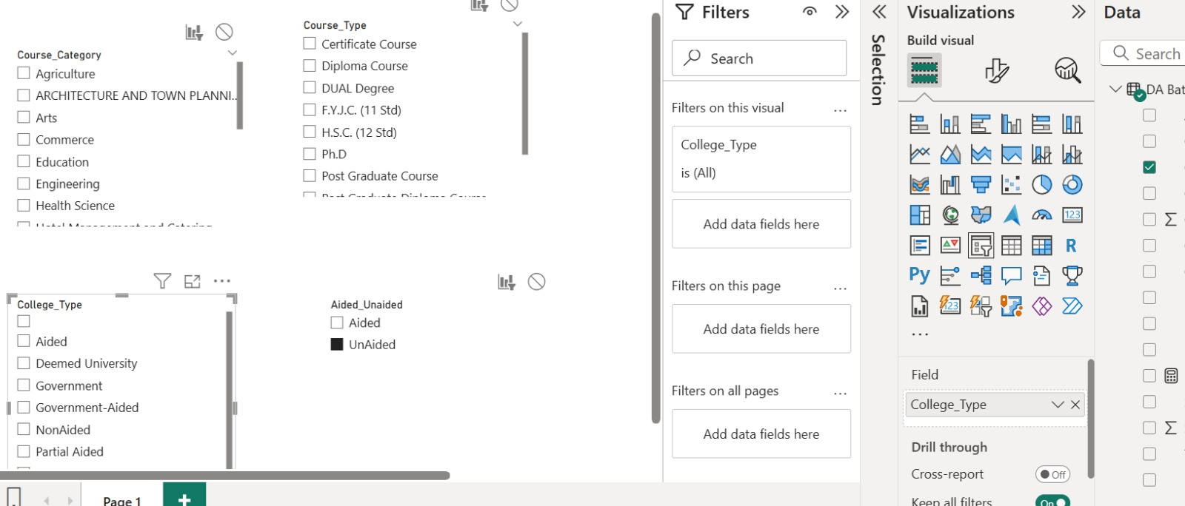
Prof_NonProf

Slide 26
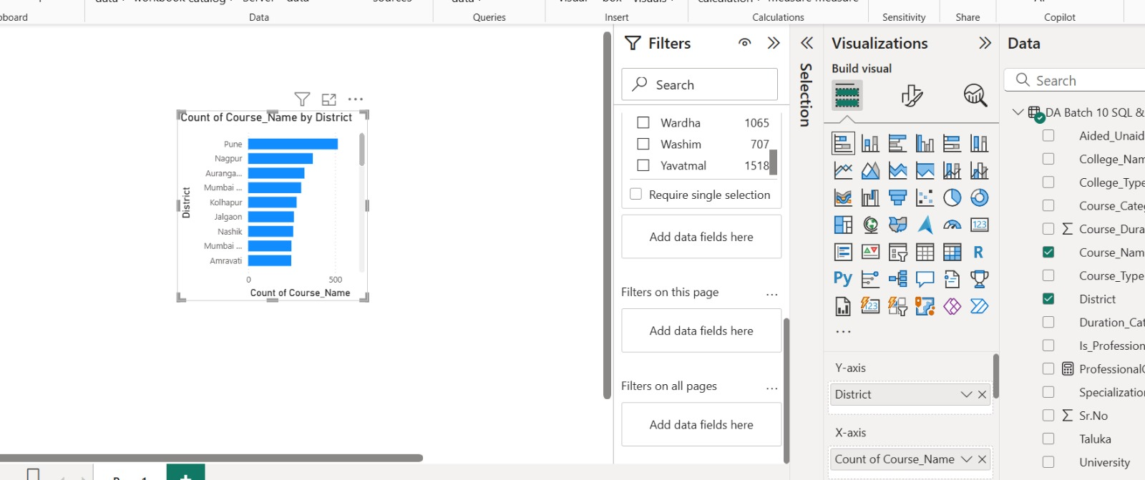
Which district has the most colleges?

Slide 27
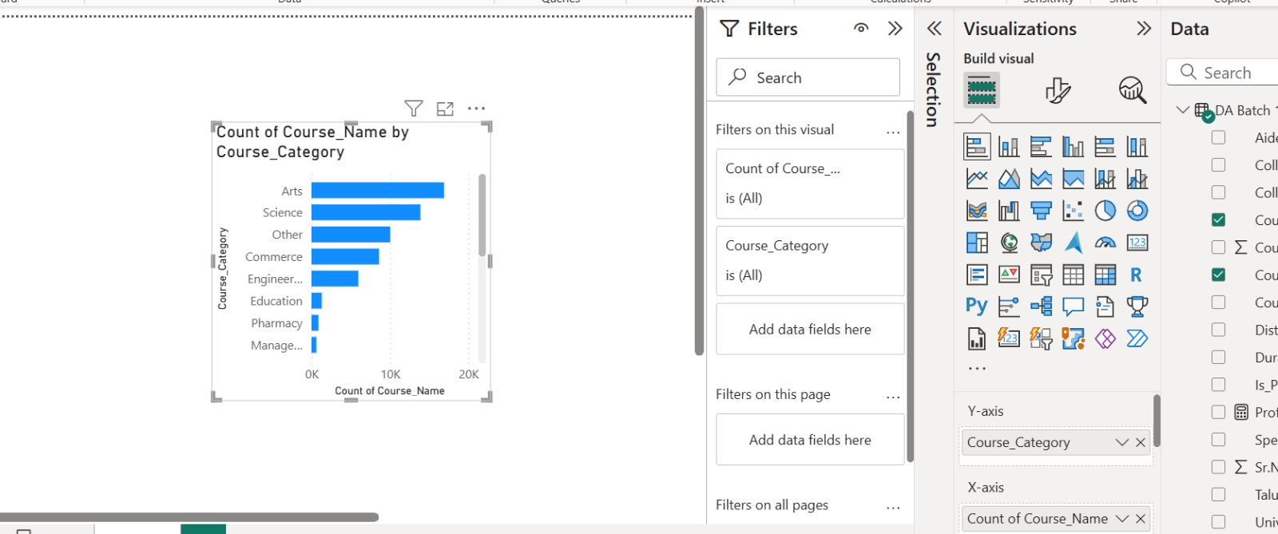
Most common course categories?

Slide 28
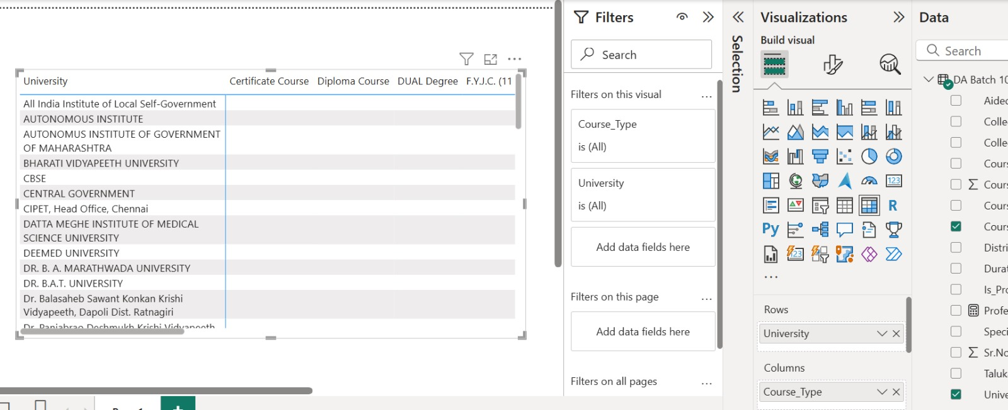
Universities with widest range of course types?

Slide 29
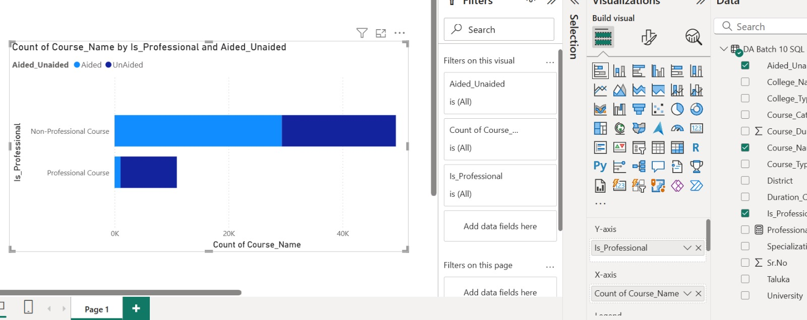
Are unaided courses more common in professional or non-professional programs?

Slide 30
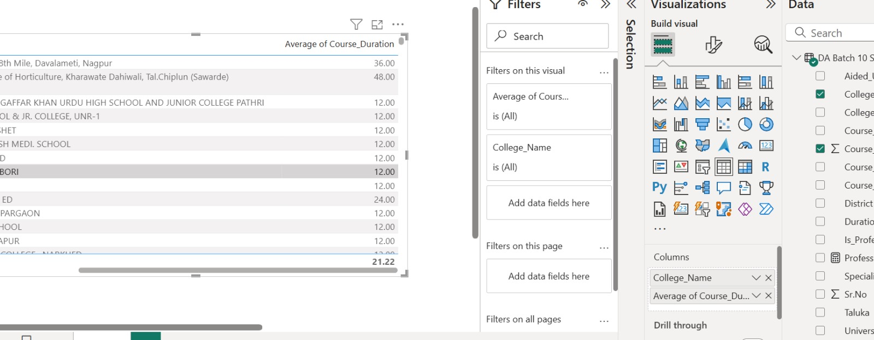
College with longest average course duration?

Slide 31
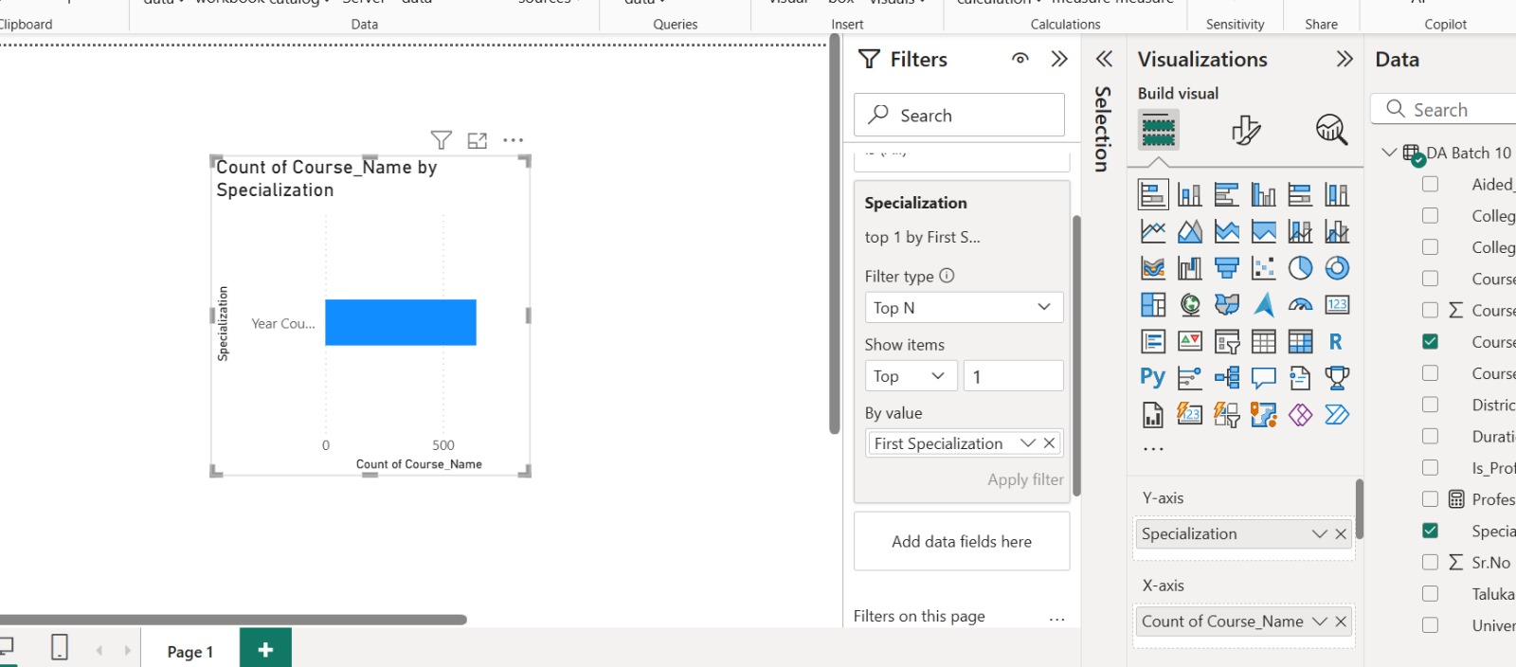
Top specialization in the state?

Slide 32
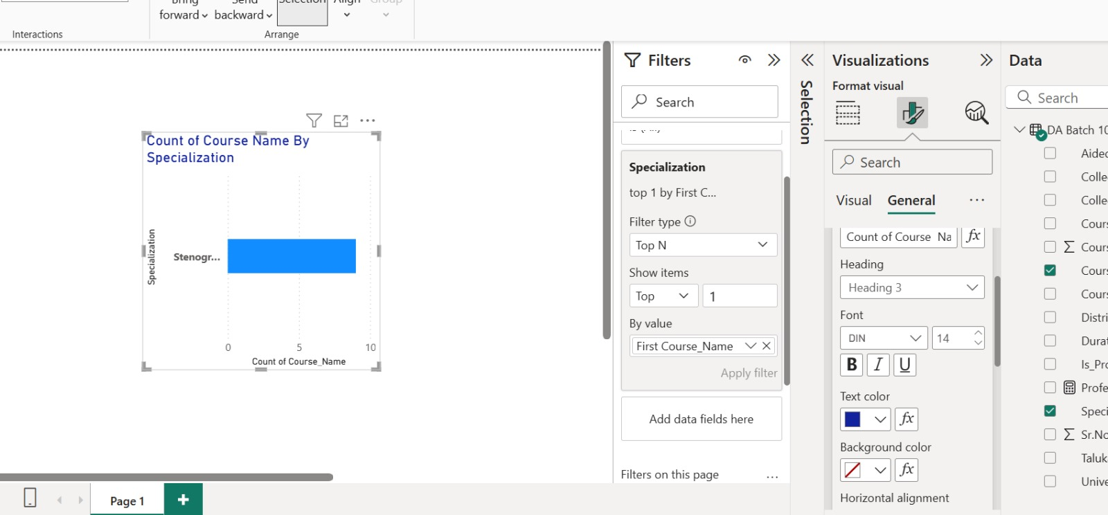

Slide 33
KEY TAKE AWAYS
Developed hands-on skills in data cleaning, transformation, and modeling using Power BI.
Extracted new dimensions such as specialization and duration categories from raw data.
Created dynamic KPI cards and charts to highlight trends in course and college data.
Implemented slicers and interaction filters for flexible and user-driven analysis.
Answered real-world business questions using visual storytelling and interactive dashboards

Slide 34
CONCLUSION
This project highlighted the end-to-end process of transforming raw educational data into a professional and actionable dashboard using Power BI. The insights derived from this analysis can help institutions and policy-makers understand regional course offerings, professional trends, and institutional reach. The interactive features allow users to engage with the data directly, making the dashboard a powerful tool for informed educational planning.

